Slide 1
Lecture 5
Trust and the digital economy

Slide 2
Question:
Title: Presentation
Subtitle field
Does the economic value always increases with the amount of data, quality, velocity, …?
In other words: is there an economic value to anonymity?

Slide 3
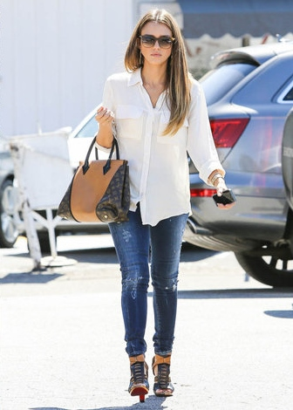
Economics of trust
Title: Presentation
Subtitle field

Slide 4
Trust in economic theory
Title: Presentation
Subtitle field
Risks associated with an economic transaction
Main source of risk in the digital economy: asymmetric information on the use of personal data = black box (F. Pasquale)
Collection, processing and purpose
Opacity of algorithms
Economic consequence: the self-destruction of the markets
Akerlof's “lemons”

Slide 5
How do you build trust? (1/2)
Title: Presentation
Subtitle field
Fairness and reciprocity < Experimental economics
Dictator game:
a sum of 10 euros is to be divided between two anonymous players. Player 1 makes an offer to player 2 who learns the amount.
player 2 has no power of veto and can only accept the offer made by player 1, who is therefore called the dictator.

Slide 6
Fairness and reciprocity
Title: Presentation
Subtitle field
In theory, the dictator should keep the entire sum in order to maximize his winnings.
Experimentally, however, studies show that a high proportion of participants give half the sum (5 euros) and that, on average, 20% of the total (sometimes more) is given to player 2.
Variant : Trust game
Both players have 10 EUR, player 1 can send an amount X which will be tripled to player 2, the latter can send an amount back to player 1.
Result: Player 1 donates 5 EUR on average, player 2 returns 1/3 of his endowment.

Slide 7
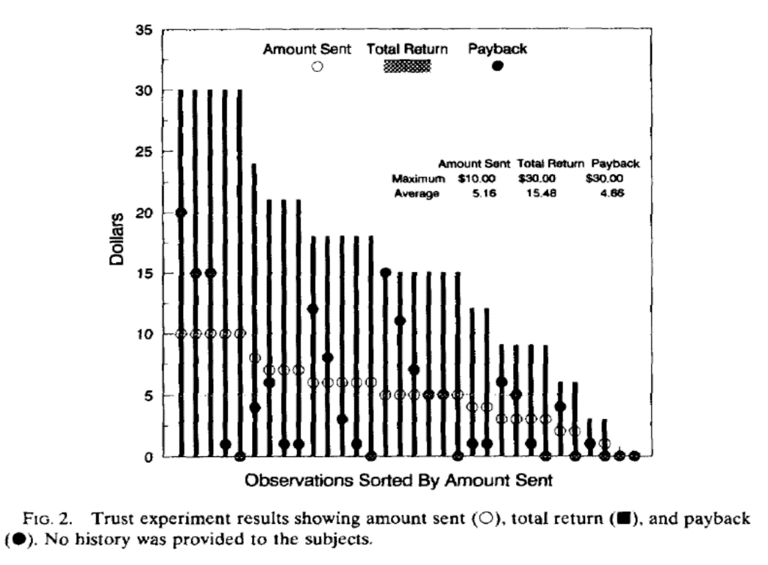
Fairness and reciprocity (cont.)
Title: Presentation
Subtitle field
Berg, Dickhaut, McCabe (1995)

Slide 8
Discussion
Title: Presentation
Subtitle field
What's more, the degree of cooperation depends on social distance and the identity of the other player.
Why?
Same belief, therefore easier to anticipate behavior

Slide 9
Critical analysis
Title: Presentation
Subtitle field
This game is essentially static, whereas the notion of trust is necessarily based on repeated interactions
Reputation matters

Slide 10
Dynamic “trust games”
Title: Presentation
Subtitle field
The prisoner’s dilemma
Two companies compete on price and sell a homogenous good
Strategy: {collusion (high prices), price war (low prices)}
Nash equilibrium: price war, 0 profits
Betrand’s paradox
One-shot; what happens if we repeat this game?

Slide 11
Repeated games: building trust 2/2
Title: Presentation
Subtitle field
Game is repeated an infinite number of times
Nash equilibrium if discount factor is small:
Tacit collusion: high price
Why?
Compare profits under collusion with profits with an opportunistic behavior
Importance of the punishment mechanism
Second way to build trust!

Slide 12
The role of institutions
Title: Presentation
Subtitle field
Religion: economic growth is positively correlated with a religion with a punitive god
Punishment helps discipline economic agents and build trust
This requires an institutional framework, non-corrupt judges
These judges may act in a purely individualistic way to preserve their reputation = microfoundation of institutions

Slide 13
Altruistic punishment
Title: Presentation
Subtitle field
Public good games < Fehr and Gaechter
Each agent can put part of his endowment into a public good
The amount in the public good is multiplied by 3
At the end, each player receives an equal share of the public good
So, each player should put his entire endowment into the public good
But free-rider problem

Slide 14
Altruistic punishment (cont.)
Title: Presentation
Subtitle field
Consider two situations: with and without punishment
Punishment is costly: each player must take from his or her own endowment to punish another player.
Without punishment: the amount allocated to the public good decreases over the rounds until a complete free-rider situation is reached.
With punishment: total amount allocated to the public good is multiplied by (6; 7.5)
Interpretation: negative emotion towards non-contributors; this generates anger.

Slide 15
Markets and anonymity
Title: Presentation
Subtitle field
From a barter and gift economy … to a market economy
How do we achieve this?
By preserving the anonymity of buyers; everyone is treated in the same way
Anonymity guarantees fairness
Question: AI makes it easier to price discriminate. What are the implications for markets?

Slide 16
Trust and signals of trust
Title: Presentation
Subtitle field
We need to anticipate the actions of the counterparty (economic or social).
This implies:
beliefs about these actions
An assessment of the risks involved
Need to reduce complexity
Dunbar's number (150)
Beyond that, too much complexity

Slide 17
How to reduce complexity
Title: Presentation
Subtitle field
Reputation
example: Ebay system
Communities and group membership
Religion
Gifts
These are examples of signals in economics

Slide 18
Trust and the digital economy
Title: Presentation
Subtitle field
Knowledge of the counterparties, their strategies, their objectives, the risks involved
Weakened by big data: secret algorithms, information bubbles, self-fulfilling prophecies generated by predictive algorithms
Fairness and reciprocity
Algorithm biases
Discrimination and algorithmic governance
Users get nothing, big tech companies earn billions of USD
Institutions and punitive mechanisms
fake news, data theft with no consequences

Slide 19
Title
Subtitle

